Slide 1



IA Dashboard 1.30
View in Power BI
Last data refresh:
1/30/2024 7:19:02 AM UTC
Downloaded at:
3/25/2025 8:41:40 PM UTC

Slide 2
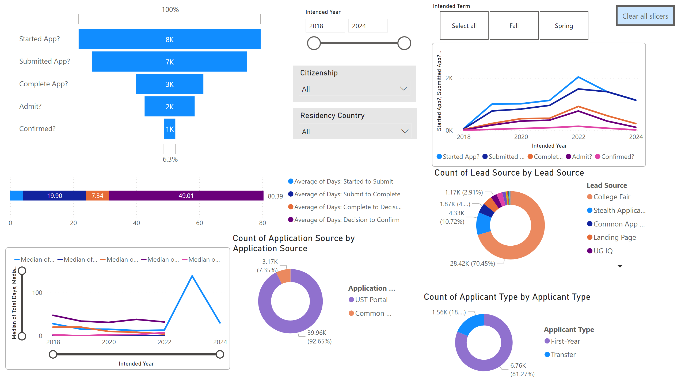
Admission Summary
Notes:
actionButton
No alt text provided
lineChart
No alt text provided
lineChart
No alt text provided
slicer
No alt text provided
donutChart
No alt text provided
donutChart
No alt text provided
donutChart
No alt text provided
slicer
No alt text provided
slicer
No alt text provided
slicer
No alt text provided
slicer
No alt text provided
barChart
No alt text provided
funnel
No alt text provided

Slide 3
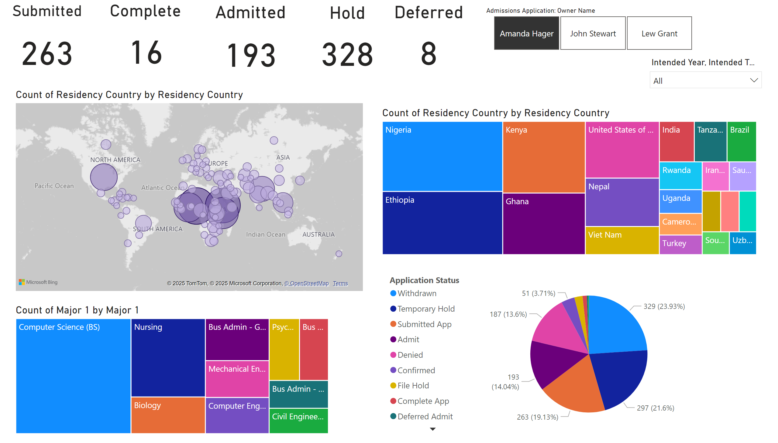


KPI
Notes:
map
No alt text provided
slicer
No alt text provided
Submitted
No alt text provided
Hold
No alt text provided
Complete
No alt text provided
Admitted
No alt text provided
treemap
No alt text provided
treemap
No alt text provided
Deferred
No alt text provided
pieChart
No alt text provided
slicer
No alt text provided

